Slide 1
McDonald’s Feedback Analysis Social Media Command Centre
Problem Statement Reminder
Using GenAI to analyze McDonald's customer feedback and generate actionable insights for management.
Repo link
github.com/IS492-SP26/team-project-social-media-command-centre/
Checkpoint #2 Presentation | IS492 | University of Illinois Urbana Champaign
Pranav C | Jeet T | Ashish G

Slide 2
What We Needed to Validate
Assumption | Initial Belief | Why It Could Be False | Mitigating Feature
Reviews are representative | Reflects all customers | Skews toward extreme opinions | User survey validation (15 participants)
RoBERTa fits restaurant text | Tweet-trained model works on reviews | Language patterns differ significantly | RoBERTa pre-trained on 124M tweets
Sentiment = actionable insight | Scores alone guide operations | Lacks specificity on issue type | Aspect-level sentiment tagging + geographic drill-down
Notes:
During Checkpoint 1, we made three core assumptions — and each one had a real risk of falling apart.
First, we assumed Google reviews would give us a fair picture of customer sentiment. But in reality, most people only bother reviewing when they're thrilled or furious. To counter this, we ran a survey with 15 real McDonald's customers to validate whether our findings actually matched lived experience.
Second, we chose RoBERTa as our model assuming it could handle restaurant review language. This was a calculated bet — RoBERTa was pre-trained on 124 million tweets, so it understands informal, opinionated text better than alternatives like VADER or DistilBERT.
Third, we assumed sentiment scores alone would be actionable for management. They're not — saying 'this location scores 3.2' tells you nothing. So we layered in aspect-level tagging across food, staff, and atmosphere, and built geographic drill-downs in Power BI so leadership can pinpoint exactly what's going wrong and where

Slide 3
What’s New and What’s Next ?
Checkpoint 1
Explore problem scope and feasibility
Checkpoint 2
Extract, clean, transform, visualize data (because unclean data == useless data)
Checkpoint 3
Develop and validate the NLP GenAI model
Checkpoint 4
Showcase PowerBI dashboard and analyze user adoption
Notes:
Checkpoint 1 was about exploring the sanity and scope of the problem (is it even feasible)
Checkpoint 2 was about extracting, transforming, loading and visualizing the data (Clean data = useful data)
Checkpoint 3 will be about building the NLP model (This is where GenAI kicks in)
Checkpoint 4 will be about product demo (PowerBI Dashboard + user adoption survey analytics)

Slide 4
Prompting Study Design
Tools Tested: ChatGPT, Claude, Gemini
Why? To check if generic GenAI NLP models work for our purpose
Task Types
Typical: Sentiment classification on 10 real reviews
Edge Case: Sarcasm detection ("Great job, I waited 25 mins for cold fries")
Failure Case: Ambiguous review — confidence score ~45%
Prompt Control: All 3 models received identical prompts, inputs, and output format instructions
Conclusion: Specific Tailored models Needed (more on that later)
Notes:
To evaluate how well GenAI could support our sentiment pipeline, we tested three tools — ChatGPT, Claude, and Gemini — across five structured prompts.
We deliberately designed tasks across three difficulty levels. First, a typical case: classify sentiment and extract issues from ten real McDonald's reviews. This gave us a baseline for how each model performs under normal conditions.
Then we pushed into edge cases. We gave all three models a sarcastic review — 'Great job McDonald's, I waited 25 minutes for cold fries' — to see if they could detect that the positive phrasing was actually expressing frustration.
Finally, we tested a failure case — a vague, ambiguous review that even humans struggle to classify. The goal here wasn't to get a correct answer, it was to see whether the model knew what it didn't know — and whether it would flag low-confidence outputs for human review.
To make the comparison fair, every model received the exact same prompt, the same reviews, and the same output format instructions. That way, any differences in output came from the model itself, not from how the question was asked

Slide 5
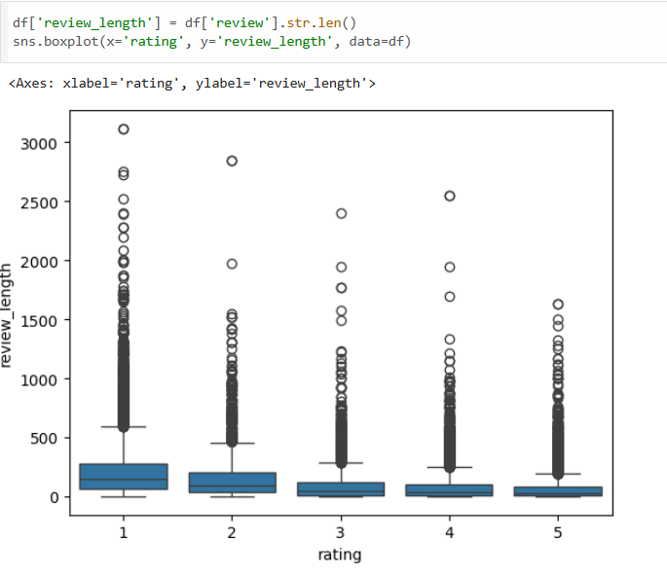
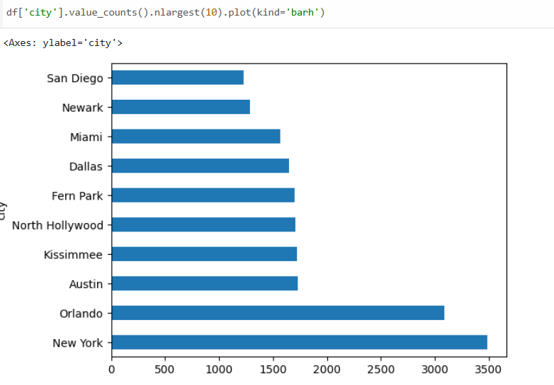
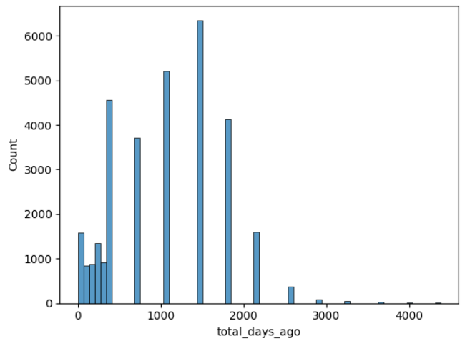
Evidence: Data Behaviour + Credibility
Notes:
We used pandas to clean the extracted data. After making sure that the data is cleaned, we performed some exploratory data analysis to get a birds eye view of the reviews we are working with.
Review recency — Most reviews were written within the last 1,500 days (~4 years), with a sharp drop-off beyond 2,000 days, confirming the dataset is relatively current
Geographic concentration — New York and Orlando dominate review volume, suggesting dataset skew toward a few high-traffic urban markets
Negative reviews are more detailed — 1-star reviews are noticeably longer than 5-star reviews, meaning dissatisfied customers write more — reinforcing the extreme-opinion bias assumption

Slide 6
Gap Analysis & Opportunity
Existing tools rely on sentiment & star ratings → miss operational context
Fail on sarcasm, mixed sentiment, vague feedback → risk misclassification
Rating-text mismatches hide real issues → undetected problems
No uncertainty awareness → ambiguous reviews ignored
Tool | Limitation | Our Opportunity
Sentiment dashboards | Only pos/neutral/neg | Extract operational issues
Keyword-based tools | Misinterpret language | Context-aware LLM understanding
Rating-based systems | Rating-text mismatch | Detect hidden issues
Traditional ML | No uncertainty | Flag ambiguous reviews
Notes:
“Current feedback tools summarize sentiment and star ratings but fail to tell us why customers are unhappy. They misread sarcasm and mixed feedback, hide operational issues behind ratings, and ignore ambiguous cases. Our system uses LLMs to extract operational insights, detect rating-text mismatches, and flag uncertain reviews, turning raw feedback into actionable decisions for managers.”

Slide 7
Risks, Safeguards & Path to CP3
Risk Type | Risk | Mitigation
Privacy | Reviews contain real names or locations | Strip PII during data cleaning
Reliability | Model misclassified sarcasm or ambiguity | Flag low confidence outputs below 60 percent for human review
Cost | LLM API calls at scale are expensive | Use batch processing and cache repeated queries
Reliability | Hallucinated operational recommendations | Ground outputs strictly in actual review text
Checkpoint 3 Target: Setup the NLP model framework
Notes:
As we moved from planning to implementation, three new risk categories surfaced that weren't in our original scope.
The first is privacy. Google reviews sometimes include real customer names, staff names, or specific location details. At scale, processing and storing this data introduces exposure risk, so our mitigation is to strip any PII during the cleaning pipeline before it ever enters the model.
The second is reliability. Our testing showed that models struggle with sarcasm and ambiguous reviews — sometimes with confidence as low as 45%. Rather than trust every output blindly, we use a 60% confidence threshold — anything below that gets flagged for human review instead of feeding directly into the dashboard.
The third is cost. Running transformer-based models like RoBERTa on thousands of reviews isn't free, especially at API scale. Our plan is to use batch processing and cache results for reviews that have already been scored, so we're not re-running the model on the same data repeatedly."

Slide 8
Questions ?
Constructive Feedback Is Welcomed !
Checkpoint #2 Presentation | IS492 | University of Illinois Urbana Champaign
Pranav C | Jeet T | Ashish G

